Slide 1
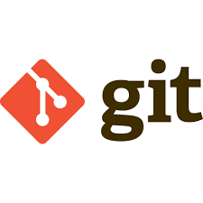

Slide 2
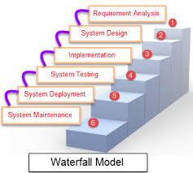

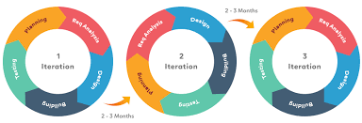


SDLC
Disadvantages:
Linear sequential
Client requirement may changes
Difficult to handle complex queries
Disadvantages:
Conflicts between dev and delivery
Configuration Mismatches
No continuous Deployment
Automation and tools + AGILE
Set the Roadmap to software delivery
Preferred Skill: Communication, Collaboration and Philosophies
Usage: Enables Organiation ability to deliver the high end project
Objective /Goal: Eliminate wastages from Project via CSI [ITIL]

Slide 3
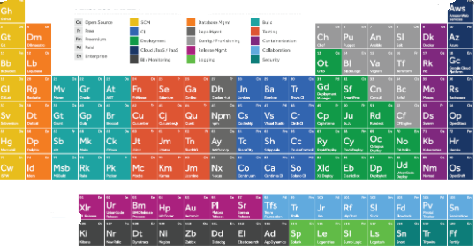
DEVOPS – PERIODIC TABLE

Slide 4
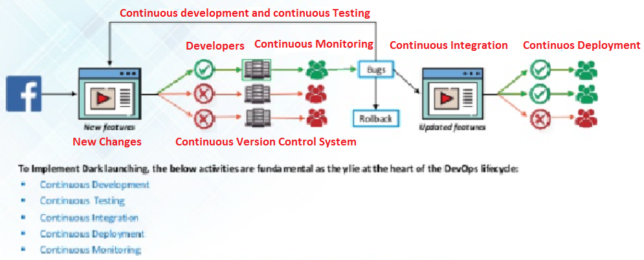
USE CASE: DARK LAUNCHINIG
SINGLE USER BASE and CI CD : Facebook introduced on 2005.
In 2009 kick started and completed in 2011, Facebook decided to undergo huge change
Single user base Technique
Everything done on a continuous fashion and moved the build to production once all issues recovered.

Slide 5
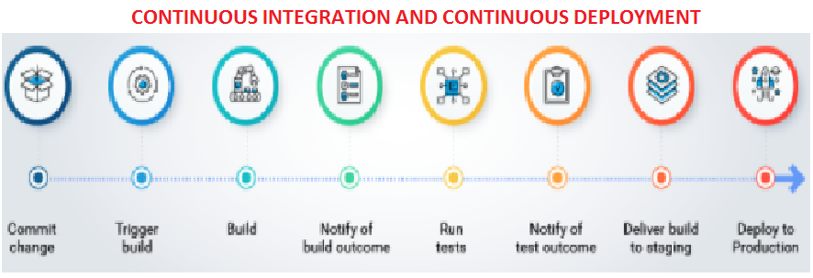
CI CD PIPELINE
CI CD PIPELINE
COMMIT – Record the changes made and commit
BUILD (Compilation, Code_review, Validation, Unit Test, Integration Test, Packaging)
TEST– Test report notification to the user
MONITORING : Notify bug report to developers
UAT DEPLOYMENT: Implementation on Testing Environment
PRODUCTION DEPLOYMENT: Implementation on Production Environment

Slide 6
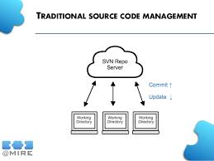

TRADITIONAL METHODS AND CHALLENGES
CHALLENGES
REBUILT
COLLABRATION
COMMIT
DEBUG
AVAILABILITY
RECOVERY
BACKUP AND RECOVERY
FLEXIBILITY
DURABILITY
SECURITY

Slide 7
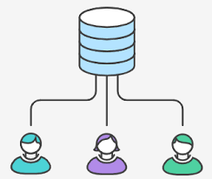
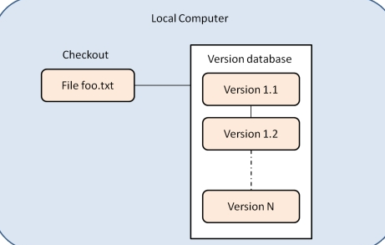
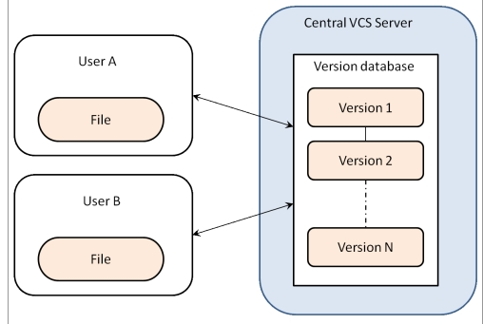
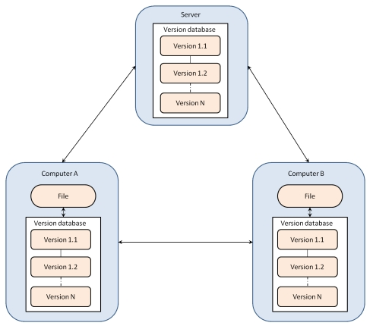
WHAT IS VCS AND TYPES
Version Control Systems are process management systems which maintain changes recorded in a file or set of files over period of time. ... Up to date history is available for the document and file types. It does not require any other repository systems. The repositories can be cloned as per the need and availability.
TYPES OF VCS
Local Version Control System
Centralized Version Control System
Distributed Version Control System

Slide 8

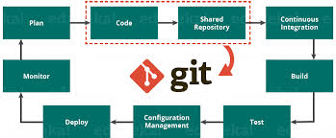
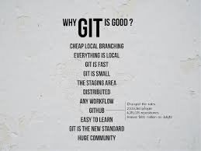
GIT {CHARACTERISTICS}
History
On 2005, Linus Torvalds who invented Linux was introduced GIT just to manage the Linux Kernel
GIT Characteristics :
Economical
Non-Linear
Distributed
Durable
Secured
Snapshots
Recovery and Backup
Branching
Intigrity
Availability
Flexibility
Git is a free, open source distributed version control system tool designed to handle everything from small to very large projects with speed and efficiency. It was created by Linus Torvalds in 2005 to develop Linux Kernel. Git has the functionality, performance, security and flexibility that most teams and individual developers need.

Slide 9
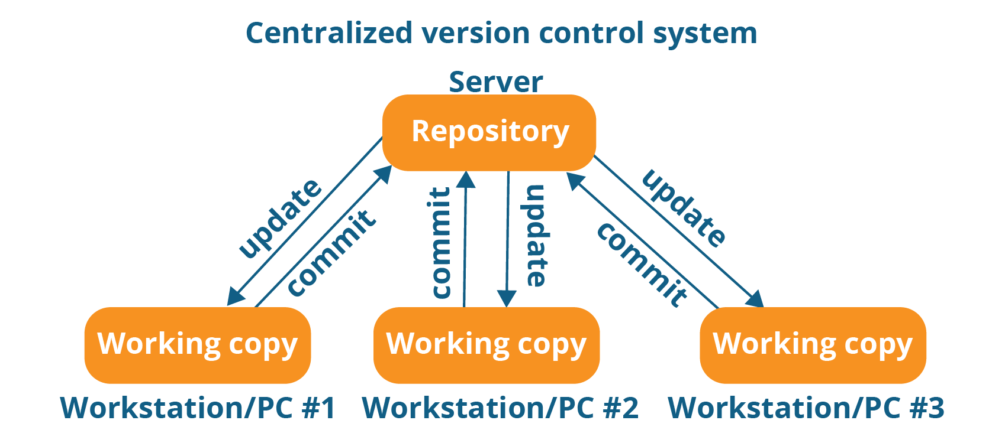
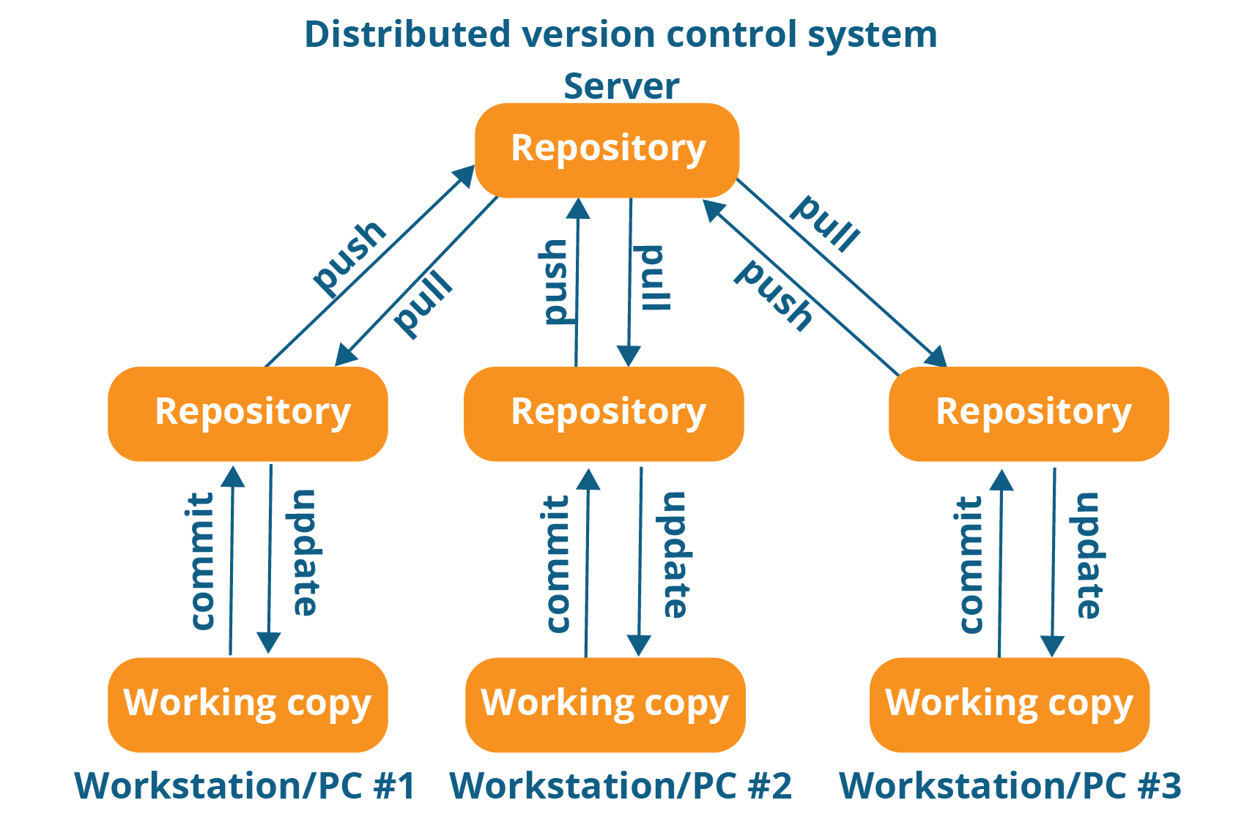
DVCS vs. CVCS
CVCS | DVCS
Everything store in one centralized Repo | Staging Area
Recovery and Backup is concern | Internet need only from Local to Remote operations
No collaboration; Downtime; Commit; Availability also a conocern | Everything maintained locally
Need network for end to end operations | Cloning on Remote Repo
 | High Level of Collaboration; Low level of Outages;

Slide 10
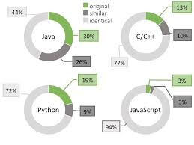

O/S SUPPORTS AND USERS
OPERATING SYSTEMS:
Linux (Debian) – UBUNTU, SUSE, REDHAT
Linux (Fedora)
Linux (Centos)
Microsoft Windows
MAC
SOURCES:
All sources except .exe it adopt to load and manage
USERS:

Slide 11
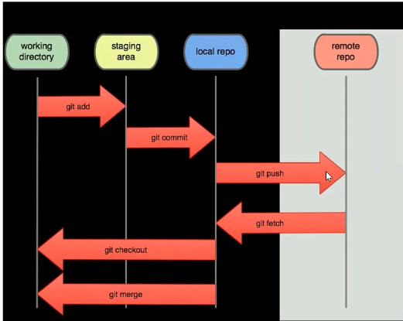
GIT FLOW AND COMPONENTS

Slide 12
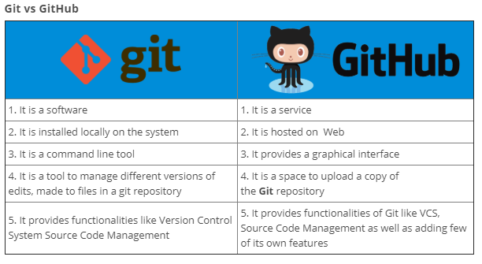
GIT VS GIT HUB

Slide 13
GIT COMMANDS
COMMAND | EXECUTION
yum install git-core; apt install git | Installation software git in Linux or Ubuntu git --version {check version}
git config --global user.name “Akshiv20” git config --global user.email “queenprince20@gmail.com” git config --global core.editor vim git config --global core.compression 2 git config --global diff.tool vim.diff | Configuration setup - Make the server Private setting the user as a global, so the entire server will be used by one user - not a recommended process
git config user.name “Akshiv20” git config user.email “queenprince20@gmail.com” | Configuration setup - make the sever Public through configuration Enable Multiple Developers use an single server
mkdir mygit | Making an Working Directory and This is local Workstation
cd mygit | change directory
git init | Make a Local repository .git => contains configuraion, commit informations
git add filename git add . git add --all | add an particular file to staging add files from current directory to local repository add all files from the directory
git diff git diff --staged | shows difference between working directory and staging area shows differences between staging and local repository
git commit -m "Commit Description" git commit -am "Commit Description” | save to local repository .git we can ignore add to staging area and move directly to Local repository
git config -l | Configuration verification
git status -l | Tells status of uncommitted changes
git log git log --oneline | Tells the logs for each commit ; Tells commit wise log Shows commitwise history ; commit id, commit msg, Authour &Timestamp
git show commitid | shows commitwise changesDetailed information about specified commit
git blame filename | shows changes made to the files Line by line history of the commit

Slide 14
GIT COMMANDS
Create an GITHUB ACCOUNT : https://github.com/join
COMMAND | EXECUTION
git remote add origin https://github.com/Akshiv20/GIT2019.git git push origin master | variable is set pushed to remote repository
For each push need to pass credentials

